Slide 1
Week 7
Time series data

Slide 2
1. Sales Forecasting
Example: A retail company analyzes past sales data to forecast future demand for different products.
Method: ARIMA, Exponential Smoothing, or LSTM models.
Use Case: Inventory optimization, production planning, and budgeting.

Slide 3
2. Stock Market Analysis
Example: A financial analyst examines stock prices and trading volumes to identify trends and make investment decisions.
Method: GARCH models for volatility forecasting.
Use Case: Risk assessment, portfolio management, and trading strategies.

Slide 4
3. Customer Churn Prediction
Example: A telecom company tracks customer subscription data to predict which users are likely to cancel services.
Method: Hidden Markov Models (HMM), Survival Analysis, or Recurrent Neural Networks (RNN).
Use Case: Customer retention strategies and targeted marketing.

Slide 5
4. Website Traffic and User Behavior Analysis
Example: An e-commerce business monitors daily website traffic to optimize marketing campaigns.
Method: Seasonal Decomposition of Time Series (STL), anomaly detection techniques.
Use Case: Digital marketing, ad spend allocation, and conversion rate optimization.

Slide 6
5. Economic Indicators & Business Cycles
Example: A government agency analyzes GDP growth, unemployment rates, and inflation trends.
Method: Vector Autoregression (VAR), Cointegration Analysis.
Use Case: Policy decisions, economic forecasting, and business cycle analysis.

Slide 7
6. Fraud Detection
Example: A bank monitors credit card transactions over time to detect fraudulent activities.
Method: Anomaly detection with Isolation Forests, Bayesian change point detection.
Use Case: Fraud prevention and security enhancement.

Slide 8
7. Demand Planning & Supply Chain Optimization
Example: A logistics company predicts shipping demand fluctuations.
Method: Holt-Winters Exponential Smoothing, Time Series Regression.
Use Case: Efficient resource allocation and delivery scheduling.

Slide 9
What is Time Series Data?
Time series data is a sequence of observations recorded at regular time intervals. Examples include:
Stock prices (daily closing prices)
Temperature readings (hourly weather data)
Website traffic (daily visits)
Sales data (monthly revenue)

Slide 10
Loading and Exploring Time Series Data
Using Pandas to Load Time Series Data
parse_dates=["Date"] ensures that the "Date" column is treated as a datetime object.
index_col="Date" sets the Date column as the index.
import pandas as pd
# Load dataset
df = pd.read_csv("timeseries_data.csv", parse_dates=["Date"], index_col="Date")
# Display first few rows
print(df.head())

Slide 11
Working with Dates in Time Series Data
Converting Strings to Datetime
import pandas as pd
date_str = "2024-03-05"
date_obj = pd.to_datetime(date_str)
print(date_obj)
# Output: 2024-03-05 00:00:00

Slide 12
Handling Dates in a DataFrame
Converting a Column to Datetime Format
df = pd.DataFrame({"Date": ["2024-01-01", "2024-02-15", "2024-03-10"]})
# Convert to datetime
df["Date"] = pd.to_datetime(df["Date"])
print(df.dtypes) # Date is now a datetime object

Slide 13
Extracting Date Components
Once converted to datetime format, we can extract datetime components from the data
df["Year"] = df["Date"].dt.year
df["Month"] = df["Date"].dt.month
df["Day"] = df["Date"].dt.day
df["Weekday"] = df["Date"].dt.day_name()
print(df.head())

Slide 14
Setting Date as Index
df.set_index("Date", inplace=True)
print(df.head())

Slide 15
Filtering data by Date
Filtering by single date
df.loc["2024-03-10"]
Filtering by range of date values
df.loc["2024-01-01":"2024-02-15"]

Slide 16
Generating Date Ranges
Daily
date_range = pd.date_range(start="2024-01-01", end="2024-12-31", freq="D")
print(date_range)
Monthly
monthly_range = pd.date_range(start="2024-01-01", periods=12, freq="M") print(monthly_range)
DatetimeIndex(['2024-01-31', '2024-02-29', '2024-03-31', '2024-04-30', '2024-05-31', '2024-06-30', '2024-07-31', '2024-08-31', '2024-09-30', '2024-10-31', '2024-11-30', '2024-12-31'],

Slide 17
Adding & Subtracting Dates
Adding Days
df["Next_Week"] = df.index + pd.Timedelta(days=7)
Subtracting Dates
df["Days_Since"] = (pd.Timestamp.today() - df.index).days
(this will calculate no. of days since each date)
Notes:
Pd.Timestamp() represents a single point in time like python’s datetime.datetime() function but optimized for pandas operations

Slide 18
Uses of pd.Timestamp()
Creating timestamp from string.
import pandas as pd
ts = pd.Timestamp("2025-03-24")
print(ts)
2025-03-24 00:00:00

Slide 19
Creating timestamp from date and time.
ts = pd.Timestamp("2025-03-24 14:30:00")
print(ts)
2025-03-24 14:30:00

Slide 20
Creating timestamp form date components
ts = pd.Timestamp(year=2025, month=3, day=24, hour=14, minute=30, second=0)
print(ts)
2025-03-24 14:30:00

Slide 21
Getting current timestamp()
ts_now = pd.Timestamp.now()
print(ts_now)
2025-03-24 14:35:45.567890

Slide 22
Accessing timestamp attributes
ts = pd.Timestamp("2025-03-24 14:30:00")
print(ts.year) # 2025
print(ts.month) # 3
print(ts.day) # 24
print(ts.hour) # 14

Slide 23
Performing operations on timestamp
ts1 = pd.Timestamp("2025-03-24")
ts2 = ts1 + pd.Timedelta(days=10) # Add 10 days
print(ts2)
2025-04-03 00:00:00

Slide 24
Time Zone Handling
Converting Time Zones
df.index.tz_localize("UTC")If the index does not already have a timezone, this sets it to UTC.
.tz_convert("US/Eastern")Converts the UTC timestamps into the US/Eastern timezone.
df["Date"] = df.index.tz_localize("UTC").tz_convert("US/Eastern")

Slide 25
Resampling Time Series Data
Resampling is changing the frequency of time series data— either aggregating (downsampling) or spreading out (upsampling) data points.
Examples: Converting daily sales data into monthly revenue Converting minute-level stock prices into hourly trends Filling in missing timestamps in incomplete datasets

Slide 26
data
import pandas as pd
import numpy as np
# Create sample time series data
date_rng = pd.date_range(start="2024-01-01", periods=100, freq="D") # Daily data
df = pd.DataFrame({"Date": date_rng, "Sales": np.random.randint(100, 500, size=(100))})
# Convert Date column to index
df.set_index("Date", inplace=True)
print(df.head()) # Check the first few rows
Date Sales
2024-01-01 293
2024-01-02 253
2024-01-03 101
2024-01-04 122
2024-01-05 452

Slide 27
Downsampling
Resampling to Monthly Data
Resampling to Weekly Data
df_monthly = df.resample("M").sum() # Sum of Sales per month
print(df_monthly.head())
df_weekly = df.resample("W").mean() # Weekly average
print(df_weekly.head())

Slide 28
Upsampling
Resampling to Hourly Data without filling missing values
df_hourly = df.resample("H").asfreq() # Keeps missing values as NaN
print(df_hourly.head())

Slide 29
Example before df.resample("H").asfreq()
Value
2025-03-24 08:15:00 10
2025-03-24 09:00:00 20
2025-03-24 09:45:00 30
2025-03-24 10:30:00 40
2025-03-24 11:15:00 50

Slide 30
Example after df.resample("H").asfreq()
Value
2025-03-24 08:00:00 NaN
2025-03-24 09:00:00 20.0
2025-03-24 10:00:00 NaN
2025-03-24 11:00:00 50.0

Slide 31
Unsampling
Filling Missing Values After Upsampling
df_hourly_filled = df.resample("H").ffill() # Forward fill missing values
print(df_hourly_filled.head())
ffill() Fills missing values with the previous available value.
bfill() → Uses the next available value.
Fill with a Default Value (e.g., 0)
df_hourly = df.resample("H").asfreq().fillna(0)

Slide 32
Value
2025-03-24 08:00:00 10.0
2025-03-24 09:00:00 NaN
2025-03-24 10:00:00 20.0
2025-03-24 11:00:00 NaN
2025-03-24 12:00:00 NaN
2025-03-24 13:00:00 NaN
2025-03-24 14:00:00 40.0
2025-03-24 15:00:00 NaN
2025-03-24 16:00:00 50.0

Slide 33
Value
2025-03-24 08:00:00 10.0
2025-03-24 09:00:00 10.0 # Filled with 10.0
2025-03-24 10:00:00 20.0
2025-03-24 11:00:00 20.0 # Filled with 20.0
2025-03-24 12:00:00 20.0 # Filled with 20.0
2025-03-24 13:00:00 20.0 # Filled with 20.0
2025-03-24 14:00:00 40.0
2025-03-24 15:00:00 40.0 # Filled with 40.0
2025-03-24 16:00:00 50.0

Slide 34
Value
2025-03-24 08:00:00 10.0
2025-03-24 09:00:00 20.0 # Filled with next available value
2025-03-24 10:00:00 20.0
2025-03-24 11:00:00 NaN
2025-03-24 12:00:00 40.0 # Filled with next available value
2025-03-24 13:00:00 40.0
2025-03-24 14:00:00 40.0
2025-03-24 15:00:00 50.0 # Filled with next available value
2025-03-24 16:00:00 50.0

Slide 35
Value
2025-03-24 08:00:00 10.0
2025-03-24 09:00:00 0.0
2025-03-24 10:00:00 20.0
2025-03-24 11:00:00 0.0
2025-03-24 12:00:00 0.0
2025-03-24 13:00:00 0.0
2025-03-24 14:00:00 40.0
2025-03-24 15:00:00 0.0
2025-03-24 16:00:00 50.0

Slide 36
Custom Resampling Periods
Frequency Code | Meaning
"D" | Daily
"W" | Weekly
"M" | Monthly
"Q" | Quarterly
"Y" | Yearly
"H" | Hourly
"T" | Every Minute

Slide 37
Rolling window analysis
Sales & Revenue Analysis – Identify sales trends over time
Stock Market Analysis – Moving averages to detect trends
Website Traffic Analysis – Track engagement patterns

Slide 38
Time Series Rolling Window Analysis
Rolling Mean (Moving Average)
Reduces short-term fluctuations.
Larger window = smoother trend
df["MA_7"] = df["Sales"].rolling(window=7).mean()
# Plot sales vs. moving average
df[["Sales", "MA_7"]].plot(figsize=(10, 5), title="7-Day Moving Average")
plt.show()

Slide 39
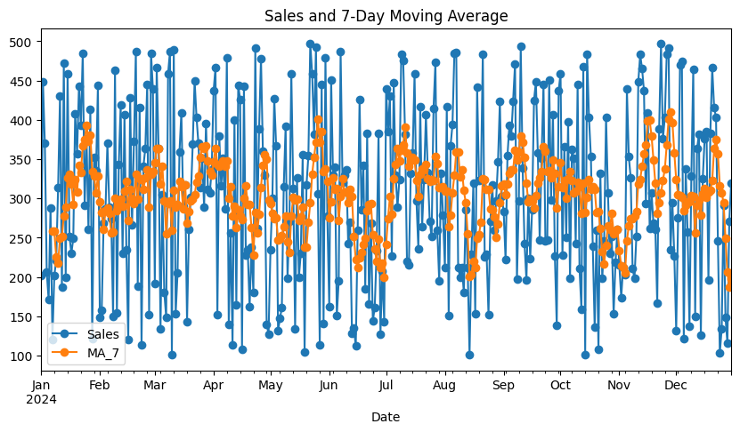

Slide 40
Rolling Sum
df["Rolling_Sum"] = df["Sales"].rolling(window=7).sum()
Show cumulative sales over past 7 days

Slide 41
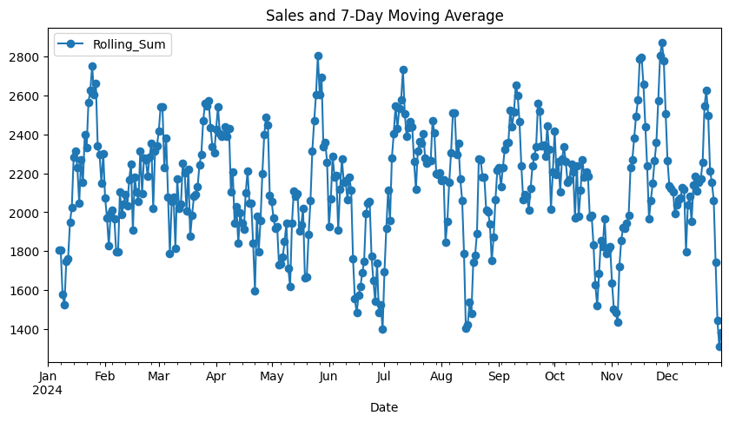

Slide 42
Rolling Min & Max
df["Rolling_Min"] = df["Sales"].rolling(window=7).min()
df["Rolling_Max"] = df["Sales"].rolling(window=7).max()
Useful for identifying the lowest & highest sales in a rolling period.

Slide 43
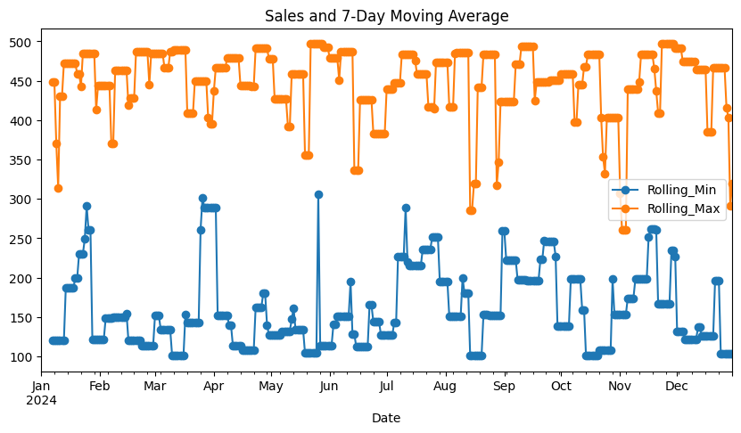

Slide 44
Weighted Moving Average (More Weight to Recent Data)
df["WMA_7"] = df["Sales"].ewm(span=7, adjust=False).mean()
Exponential Weighted Moving Average (EWMA) gives more weight to recent values
EWMA is useful in volatile data (e.g., stock prices, sales trends) to react faster to market changes.
Rolling Standard Deviation
df["Rolling_Std"] = df["Sales"].rolling(window=7).std()
Shows variability in sales over time.

Slide 45
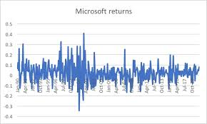

Slide 46
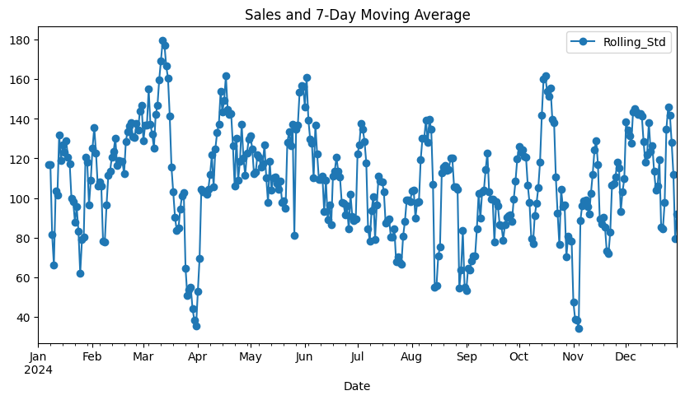

Slide 47
Detecting Anomalies with Rolling Z-Scores
df["Rolling_Mean"] = df["Sales"].rolling(window=7).mean()
df["Rolling_Std"] = df["Sales"].rolling(window=7).std()
df["Z_Score"] = (df["Sales"] - df["Rolling_Mean"]) / df["Rolling_Std"]
# Flag anomalies where Z-Score > 2
df["Anomaly"] = df["Z_Score"].apply(lambda x: "Yes" if abs(x) > 2 else "No")
print(df[df["Anomaly"] == "Yes"])
Identifies points that are significantly different from the rolling mean.

Slide 48
